Slide 1
QXU4004 Eng. Chemistry
Dr Sulafudin Vukusic s.vukusic@qmul.ac.uk

Slide 2
Week 9: Applications of Molecular Orbital Theory in Materials
Conduction, Metallic Bonding（金属键） and Band Models

Slide 3
Suggested Reading List:
Chapter 12 (Section 12.4 “Metallic bonding”, pages 530- 533; Section 12.7 Especially “Semiconductors” and “Semiconductor Doping” pages 539-544): Brown et al.
Chemistry the central science,14th int Ed, Pearson /
ISBN:978-1-292-02152-2

Slide 4

Cu
Malleable（有延展性的）, ductile, electron conducting
Metallic bonding
Polymers (C, H, maybe O,
Cl)
Plastics or elastomers, insulators（绝缘体）
Covalent bonding（共价键）

Slide 5
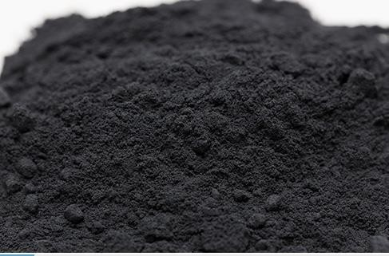

LiCoO₂
Ion conducting (cathodes lithium batteries)
Ionic bonding
Nafion
Proton conducting (polymer fuel cells)
Covalent +
Ionic bonding

Slide 6
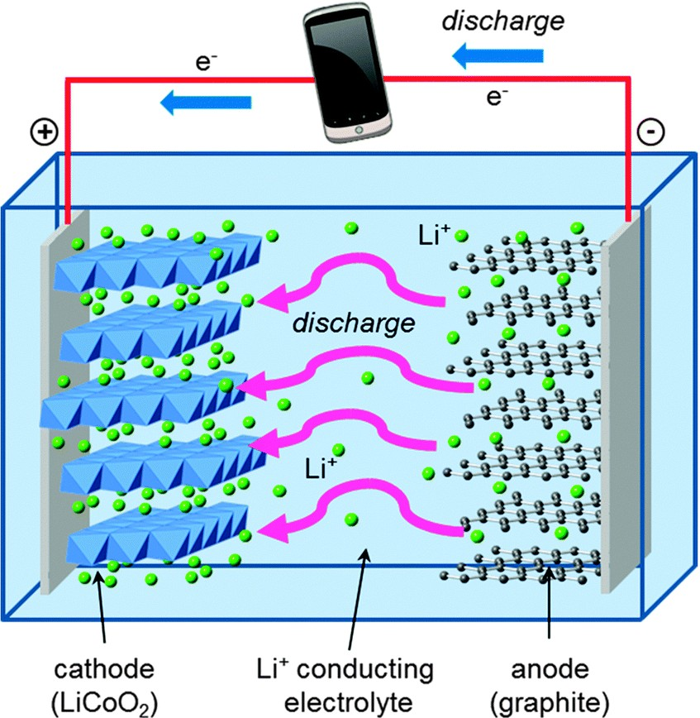
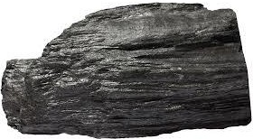

Graphite (C)（石墨）
Electron conducting, brittle（脆的）
Covalent bonding
Diamond (C)（钻石，金刚石）
Insulator, HARD
Covalent bonding

Slide 7
Ionic bonding
Atoms held together by electrostatic interactions (cations-anions). It
assumed that they are formed by electron transfer from constituent（组成的） elements completing the valence shell（价电子层）. Non-directional (charges is uniform in all directions: lattices depend on ion size and charge).
Covalent bonding
Atoms held together by sharing “relatively static” electrons to complete the valence shell. Leads to “molecules” and covalent solid networks. Directional (think of molecular shapes depending on VSEPR).
Metallic bonding
Atoms in a lattice（晶格）sharing highly mobile electrons, not completing the valence shell. 2D and 3D “metals”. Non-directional (large rearrangements possible within a lattice)

Slide 8
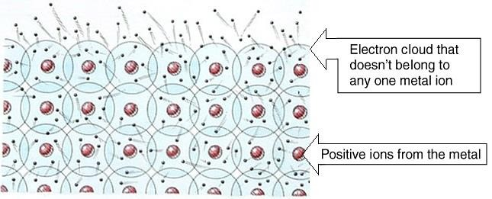
Metallic bonding
Electron sea or electron cloud model: valence electrons detached from atoms, highly mobile (leaving closely packed positive ions ‘glued’ together by electrons)
Explains electron conduction (in presence of electric field), heat conduction (to some extent, largely dependent on atom vibration), malleability and ductility

Slide 9
Electron sea or Free Electron Model of Metallic Bonding
Metals conduct heat and electricity.
Metals behave like a set of nuclei forming a lattice with a “sea of electrons” shared between all nuclei (moving freely between them):
This is the free electron or electron sea model for metals.
It explains many of the properties of metals:
Electrical Conductivity: The mobile electrons carry current.
Thermal Conductivity: The mobile electrons can also carry heat.
Malleability and Ductility: Deforming the metal leaves each cation surrounded by a “sea of electrons”, little energy is required to either stretch or flatten the metal.
Opacity and Reflectance (Shininess): The electrons have a wide range of energies, so can absorb and re-emit many different wavelengths of light.

Slide 10
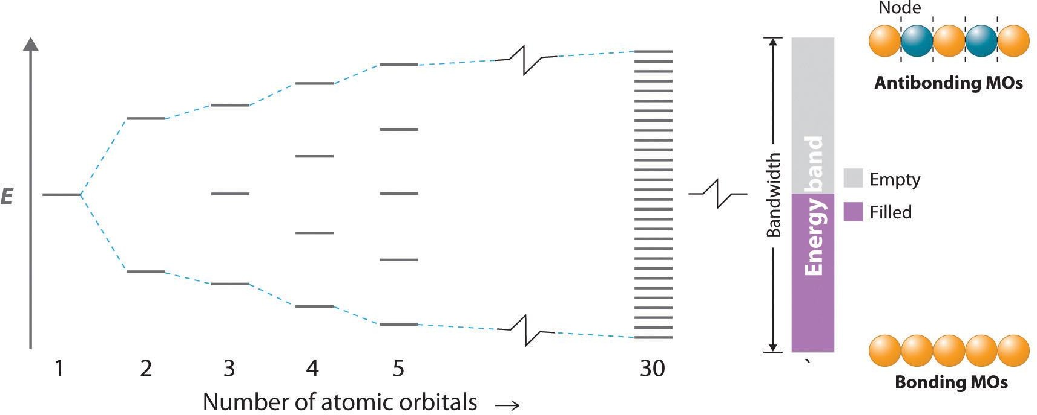
Metallic bonding
Molecular orbital or band model: (MO called states in this model)
Filled with electrons
Very large number of atoms: band: no separation between “states” (MO): continuum of energy across the band

Slide 11
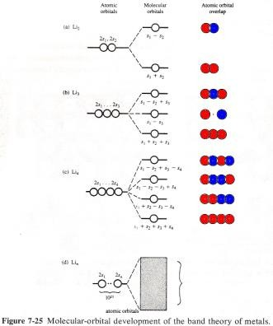
Band Theory for Metals (and Other Solids)
What do states (MO) look like?
. . . . .
4 x
2s atomic orbitals
. . . .
. . . .
. . . .
. . . .
State 4 nodes 3
Energy
State 3 nodes 2
State 2 nodes 1
State 1 nodes 0
nodes = state -1
Image adapted from “Chemical Structure and Bonding” by R. L. DeKock and H. B. Gray

Slide 12
Band Theory for Metals (and Other Solids)
Electrons in atoms or molecules are found in orbitals (atomic orbitals or molecular orbitals). What about electrons in a metal?
Can be treated in a way similar to molecular orbital theory; however, instead of MOs, we call them states.
In a metal, there are no distinct molecules. You could almost say that an
entire crystal of metal is a molecule. That’s how we’ll be treating them:
Combine atomic orbitals from every atom - states which look rather like very large molecular orbitals.
The number of states produced must equal the number of atomic orbitals
combined.
The Pauli exclusion principle（泡利不相容原理） still applies - each state can only hold two electrons.
For a metal to conduct electricity, electrons must be excited into higher energy states.
The highest energy state when no such excitation has occurred (i.e. in the ground state metal) at absolute zero (0 K) is called the Fermi energy（费米能量）. (energy of HOMO at 0K)
Conducting electricity implies to promote the electrons from lower energy states (MO) to excited (higher energy) states (MO)
In metallic conductors this is possible because the valence (filled) band is
partially filled, therefore higher energy states are available at any electric field
(V) OR because the valence and conduction band overlap.

Slide 13
Band Theory for Metals (and Other Solids)
What do states look like?
Consider lithium（锂）.
The figure at the right shows the MOs produced by linear combination of the 2s orbitals in Li₂, Li₃ and Li₄.
Note that, for every atom added:
An additional MO is formed
The energies of the MOs get closer together
When a sample contains a very large number of Li atoms (e.g. 6.022×10²³ atoms in 6.941 g), the MOs (called states) produced will be so close in energy that they form a band of energy levels.
A band is named for the AOs from which it was made (e.g. 2s band)
Image adapted from “Chemical Structure and Bonding” by R. L. DeKock and H. B. Gray

Slide 14
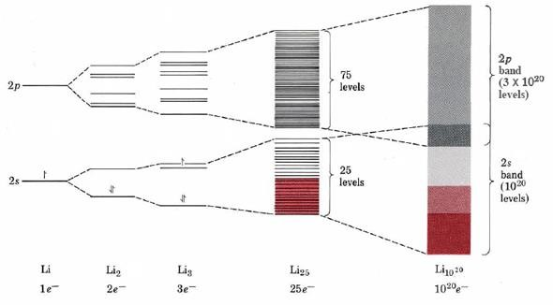
Metallic bonding
Molecular orbital or band model:
What’s the mass of 10²⁰ atoms of Li?

Slide 15
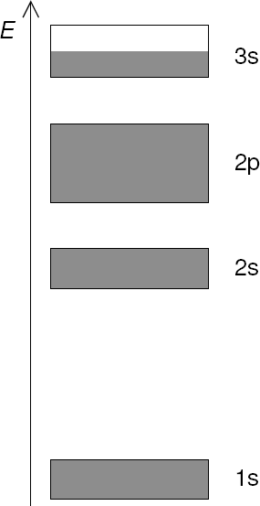
Band Theory for Metals (and Other Solids)
In an alkali碱 metal, the valence s band is only half full. e.g.
sodium
If there are N atoms of sodium in a sample, there will be N
electrons in 3s orbitals.
There will be N states made from 3s orbitals, each able to hold two electrons.
As such, N /2 states in the 3s band will be full and N /2 states will
be empty (in ground state Na).
Like all other alkali metals, sodium conducts electricity well because the valence band is only half full. It is therefore easy for electrons in the valence band to be excited into empty higher energy states.
Since these empty higher energy states are in the same band, we can say that the valence band for sodium is also the conduction band.

Slide 16
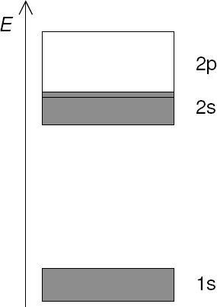
Band Theory for Metals (and Other Solids)
In an alkaline earth metal, the valence s band is full. e.g. beryllium
If there are N atoms of beryllium in a sample, there will be 2N
electrons in 2s orbitals.
There will be N states made from 2s orbitals, each able to hold two electrons.
As such, all states in the 2s band will be full and none will be empty
(in ground state Be).
So, why are alkaline earth metals conductors?
While the 2s band in beryllium is full, it overlaps with the 2p band.
As such, some electrons in the valence band can easily be excited into the conduction band.
In beryllium, the conduction band (band containing the lowest energy empty states) is the 2p band.

Slide 17
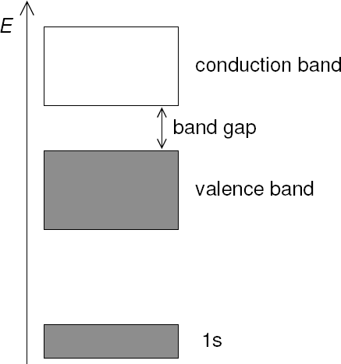
Band Theory for Metals (and Other Solids)
What do the bands look like for something that doesn’t conduct electricity? i.e. for an insulator e.g. diamond
If there are N atoms of carbon in a sample, there will be 4N
valence electrons.
The valence orbitals of the carbon atoms will combine to make two bands, each containing 2N states.
The lower energy band will therefore be the valence band, containing 4N electrons (in ground state diamond).
The higher energy band will be the conduction band,
containing no electrons (in ground state diamond).
The energy gap between the valence band and the conduction band is big enough that it would be difficult for an electron in the valence band to absorb enough energy to be excited into the conduction band. (Degradation processes that require less energy than the band gap may also occur before you excite electrons into the conduction band, depending on the material)

Slide 18
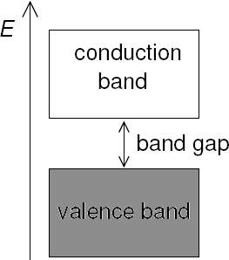
Band Theory for Metals (and Other Solids)
So, how big does a band gap have to be for a material to be an insulator?
Our measuring stick is the temperature-dependent k_{B}·T
k_{B} is the Boltzmann constant玻尔兹曼常数: 1.38065 × 10⁻²³ J/K
T is the temperature in Kelvin
k_{B}·T is a measure of the average thermal energy of particles in a sample
As a rule of thumb:
If the size of the band gap is much larger than k_{B}·T, you have an insulator. e.g. diamond: ~200×k_{B}·T
If the size of the band gap is smaller than (or close to) k_{B}·T, you have a conductor. e.g. sodium: 0×k_{B}·T, tin: 3×k_{B}·T
If the size of the band gap is about ten times larger than k_{B}·T, you
have a semiconductor. e.g. silicon: ~50×k_{B}·T
Band gaps can be measured by absorption spectroscopy（光谱学）. The lowest energy light to be absorbed corresponds to the band gap.

Slide 19
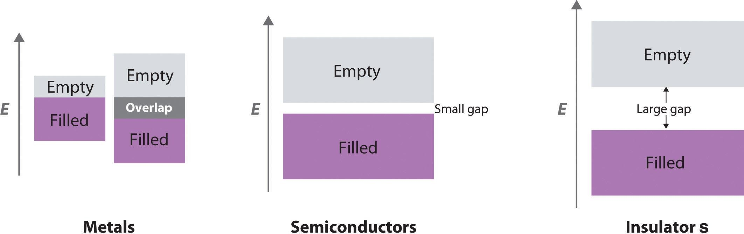
Metallic bonding
Molecular orbital or band model: Explains properties of conductors, semiconductors and insulators
Filled band: valence band Empty band: conduction band

